Slide 1
Amazon Web Services (AWS)
Atul Kahate

Slide 2
AWS Introduction

Slide 3
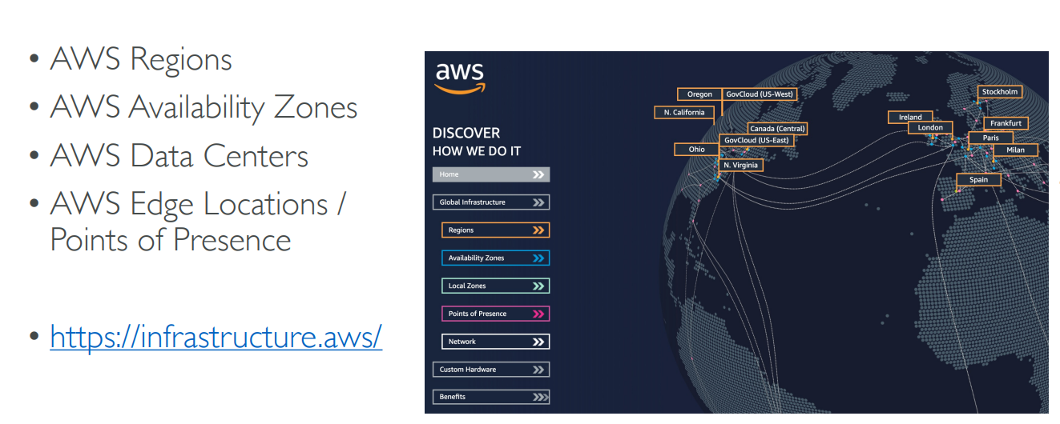
AWS Global Infrastructure

Slide 4
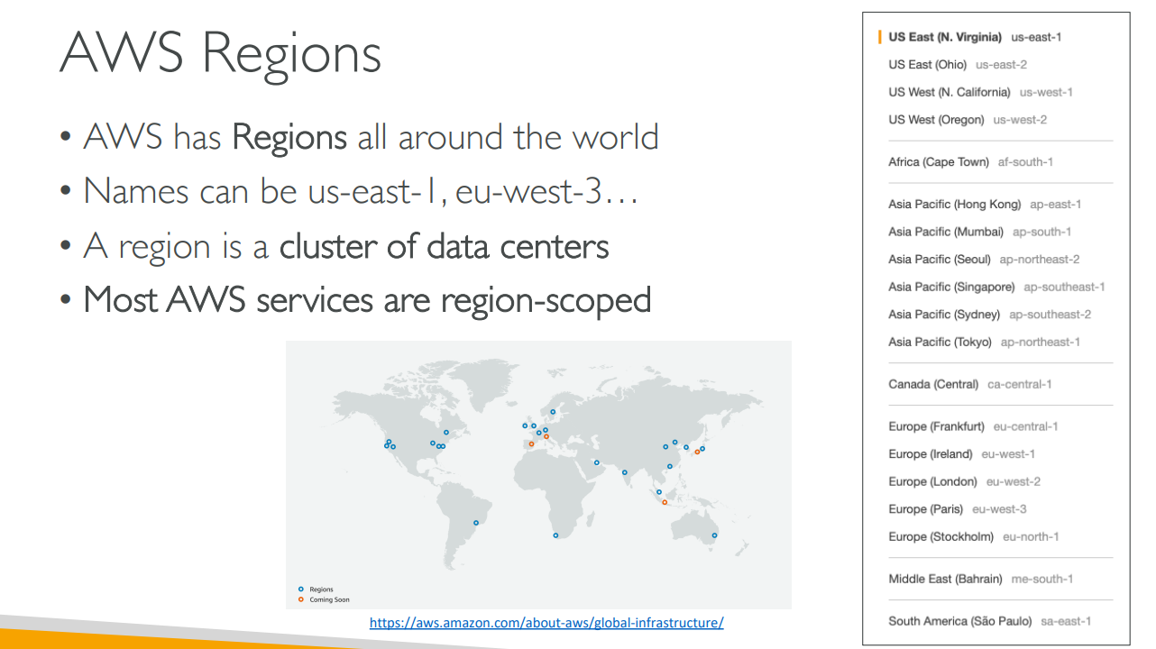
AWS Regions

Slide 5
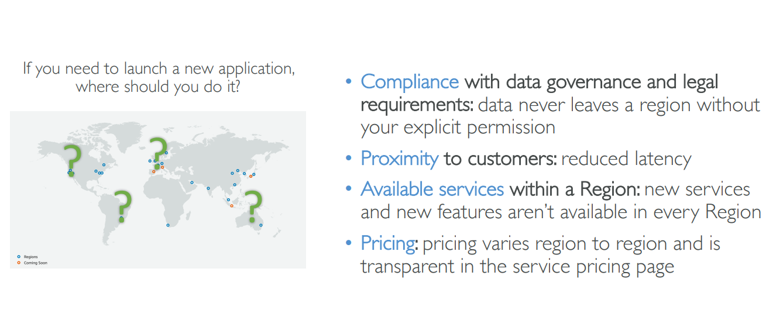
How to choose an AWS Region?

Slide 6
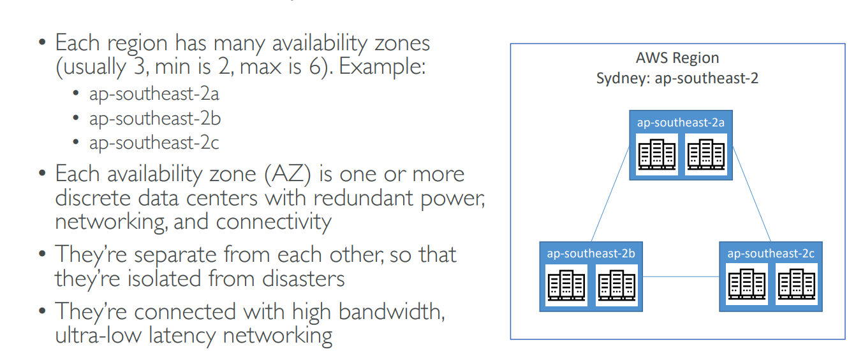
AWS Availability Zones

Slide 7
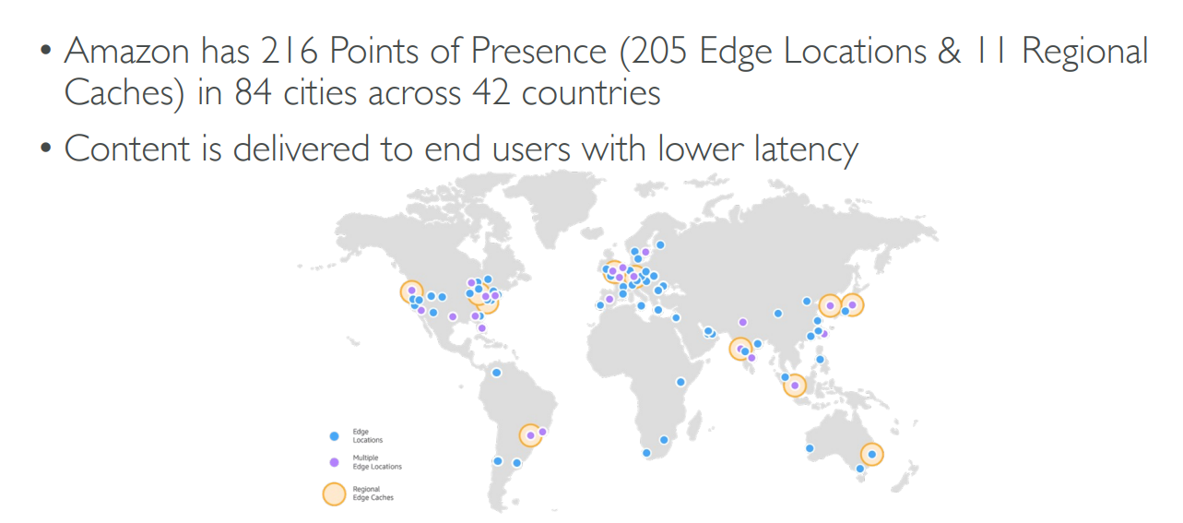
AWS Points of Presence (Edge Locations)

Slide 8
Signup
Signup for AWS with your email id
Remember the id, password and also the AWS account id (different from your email id) – This creates a root account
You will require your phone and credit card

Slide 9
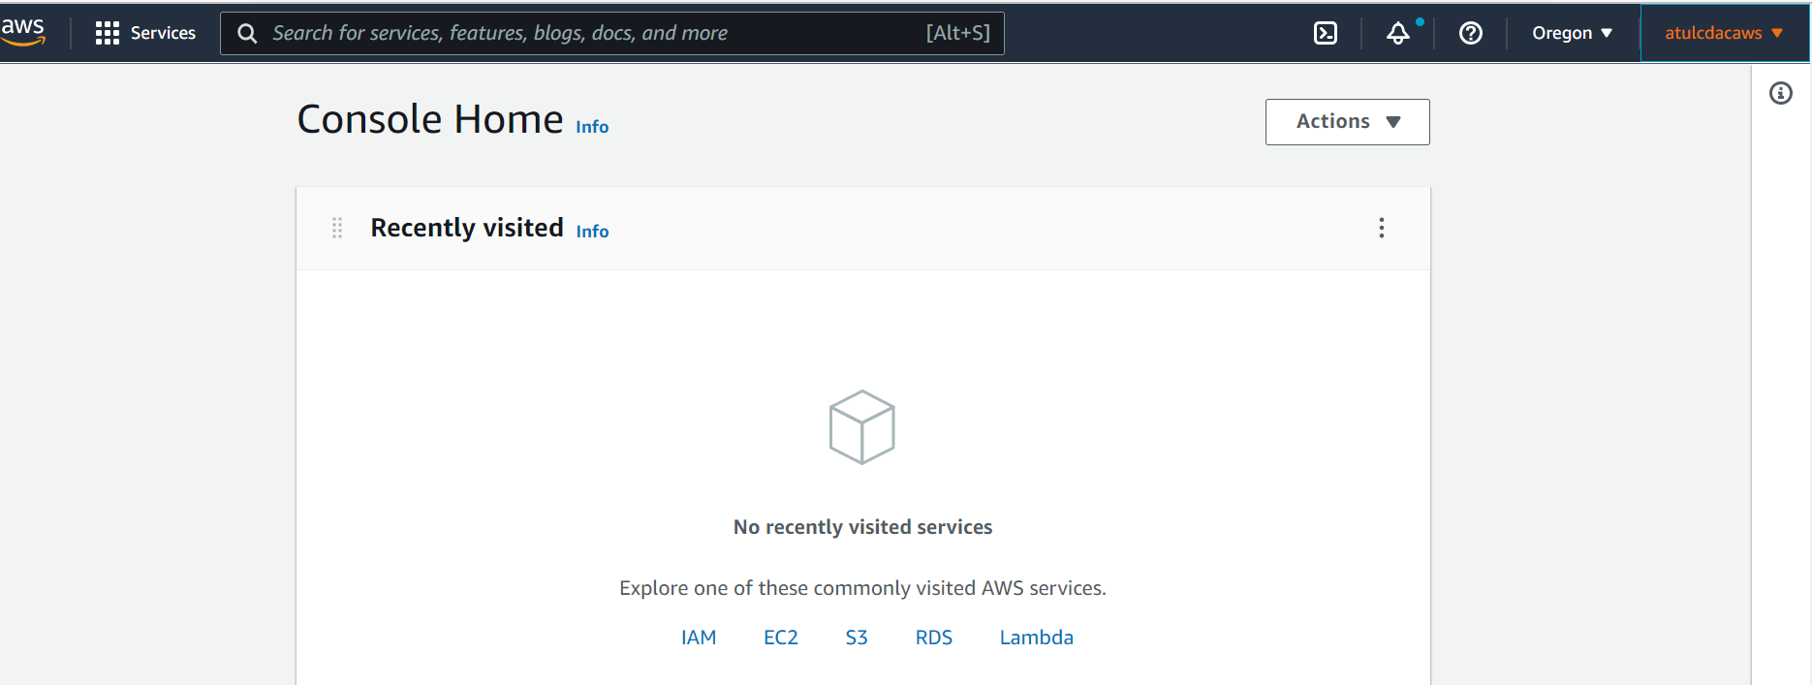
After successful signup

Slide 10
Identity and Access Management (IAM)

Slide 11
Users and Groups
When creating an AWS account, a root account is created
This should not be used for normal operations or shared
We should create users and group those users, as needed
Groups can only contain other users, and not other groups
A user can belong to no group or to multiple groups
Example: Next slide

Slide 12

Users and Groups – 1
Group: Developers
Group: Operations
Alice
Bob
Charles
David
Edward
Fred

Slide 13
Users and Groups – 2
Group: Developers
Group: Operations
Group: Audit Team
Alice
Bob
Charles
David
Edward
Fred

Slide 14
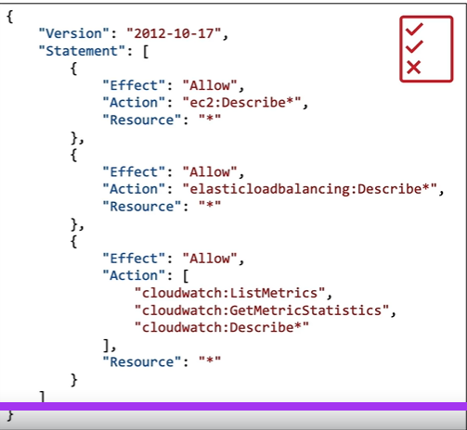
IAM Permissions
Users and groups can be assigned JSON documents called as policies
They define permissions for the users
We apply the principle of least privileges: Give only the minimum permissions that a user needs

Slide 15
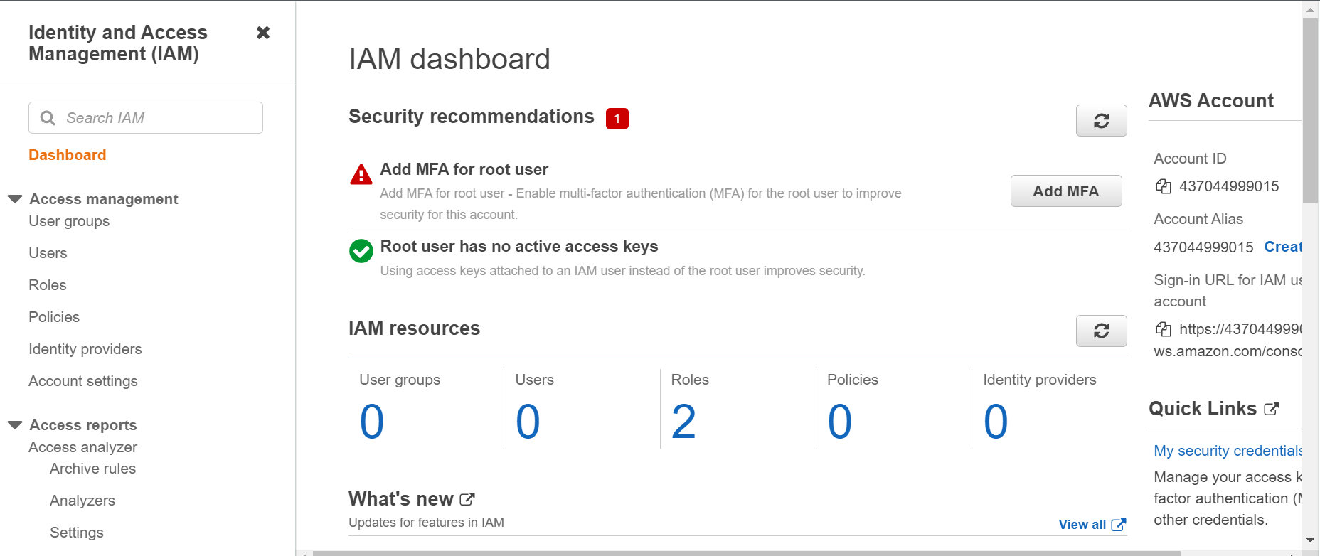
IAM Hands-on
Search for IAM in the console

Slide 16
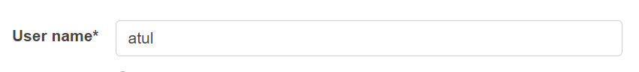
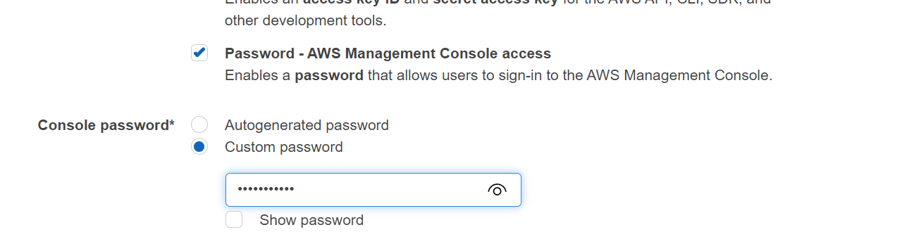
Create a User
Users -> Add Users
Since we have logged on using the root user, we should create an admin user, which we can use for further operations

Slide 17
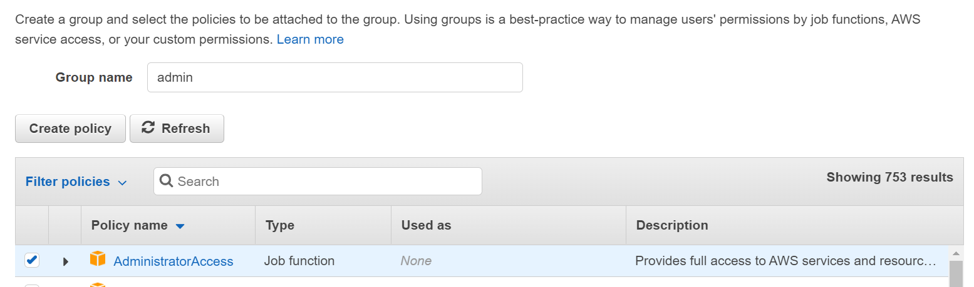
Create a Group

Slide 18
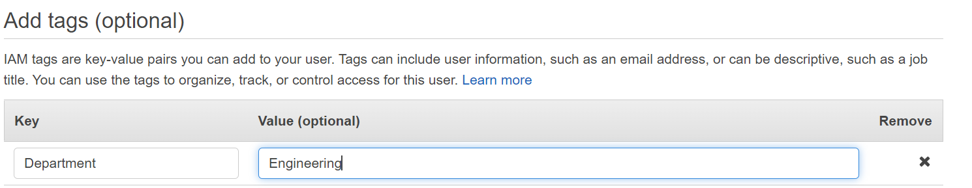
Create a Group

Slide 19
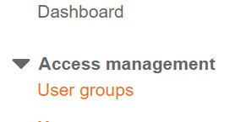
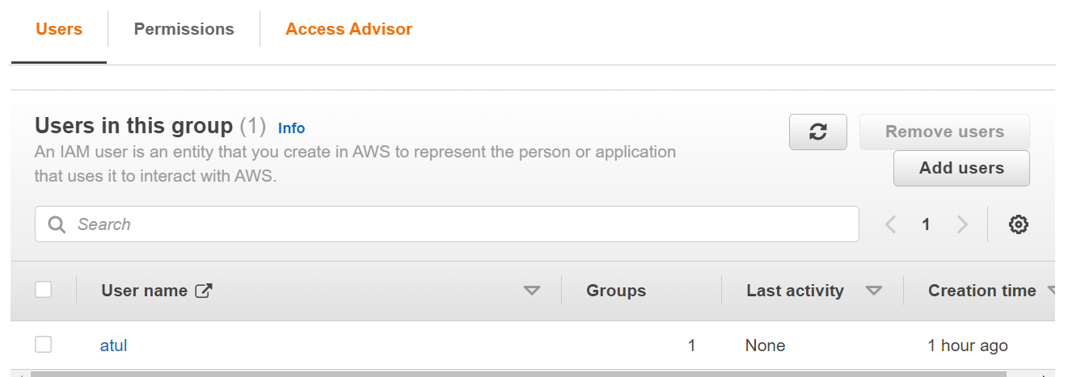
Download CSV
You will get an option to download the password in a CSV file
This will not be available later
Now click on User Groups
Click on Admin, you will see the user name

Slide 20
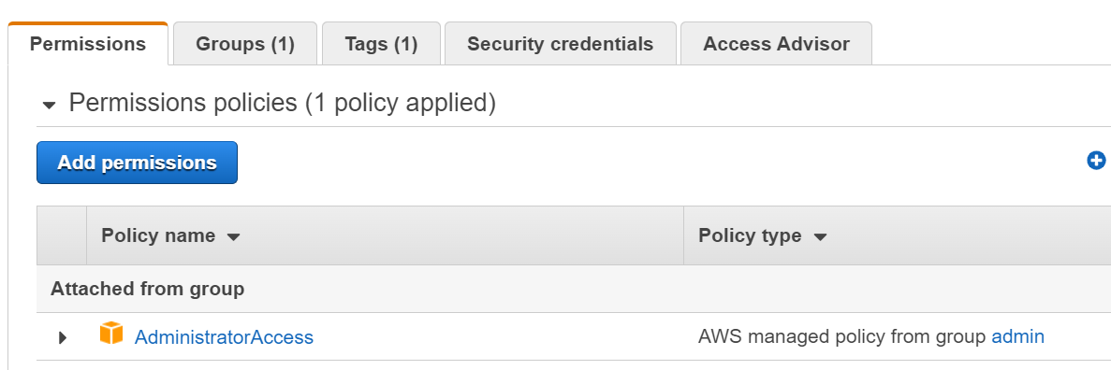
User Permissions
Click on the user name
Now click on the word ‘Admin’ under ‘Policy type’

Slide 21
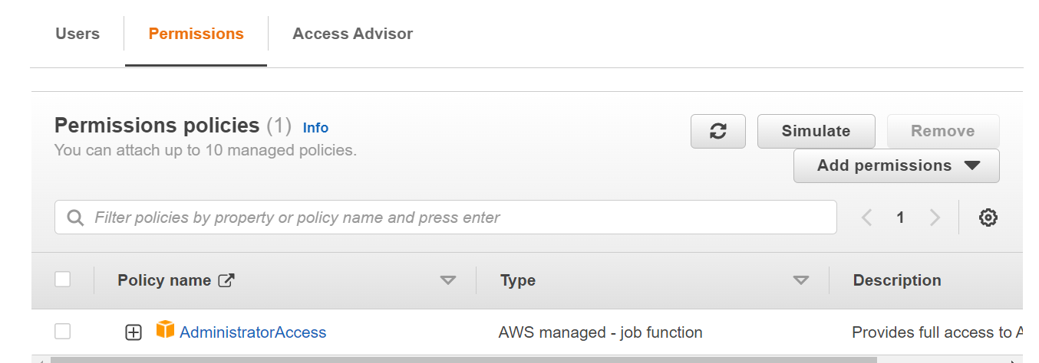
Admin Group
As we can see, this user has all the permissions

Slide 22
Try the URL
Remember your root as well as newly created user ids and passwords
Only then try this:
Go back to dashboard, copy the sign-in URL and try in another browser
It will also log you out from the current window

Slide 23
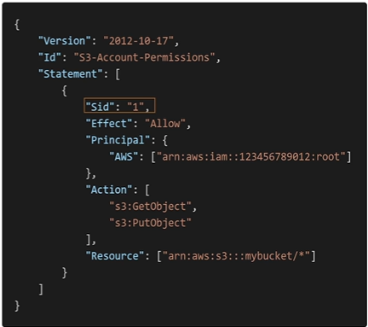
IAM Policy Structure
Version: Policy language version
Id: Optional identifier
Statement: One or more
Sid: Optional statement identifier
Effect: Allow/deny access
Principal: Account/user/role to which this is applied
Action: List of actions allowed/denied by this policy
Resource: Applicable to which resources?

Slide 24
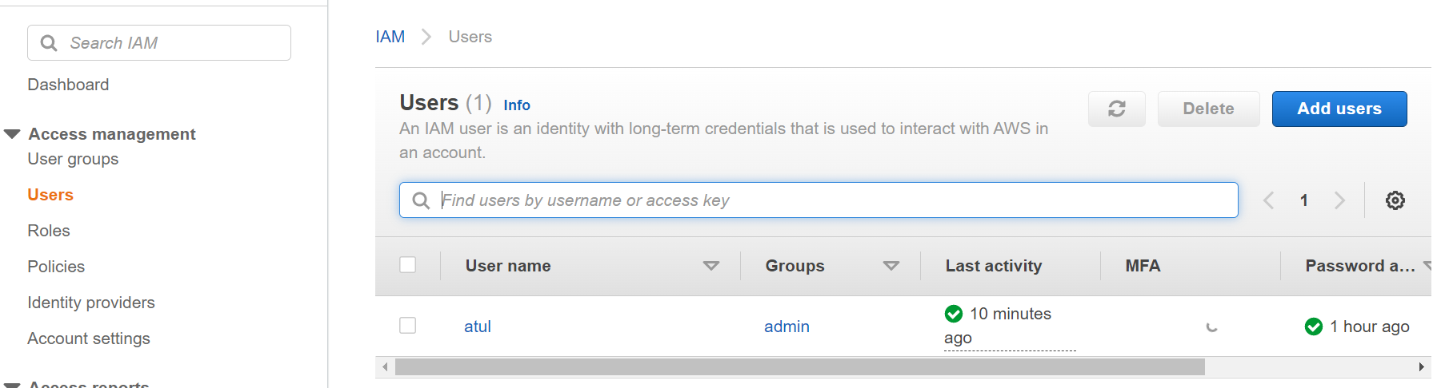
IAM Policies – Hands on
Let us try viewing a list of users

Slide 25
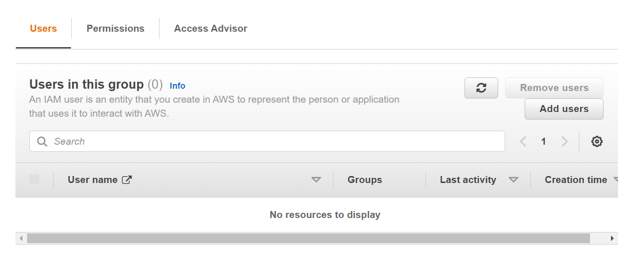
IAM Policies – Hands on
Let us remove this user from the Admin group
Click on Admin, select the user Atul and click Remove users
Now the Admin group is empty

Slide 26
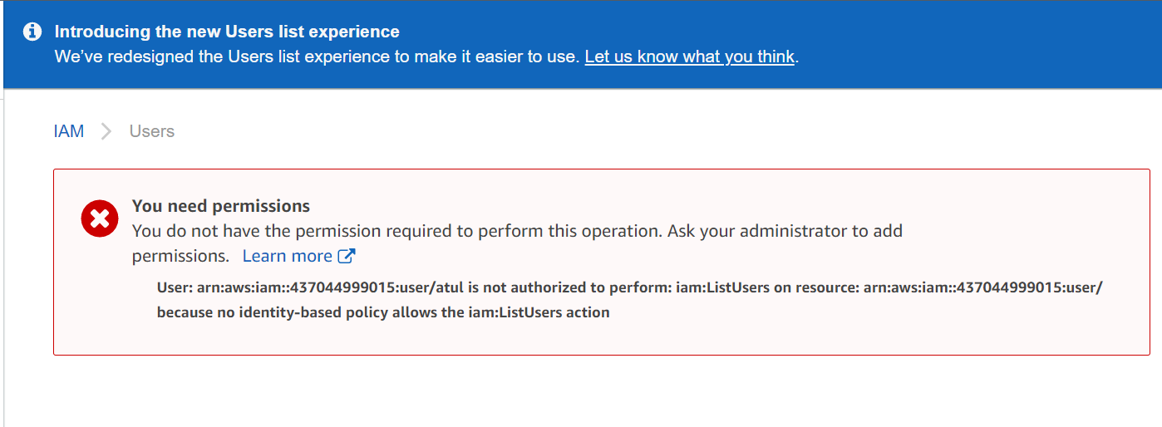
Try accessing the user list again
You may have to refresh after clicking on ‘Users’ in the left menu

Slide 27
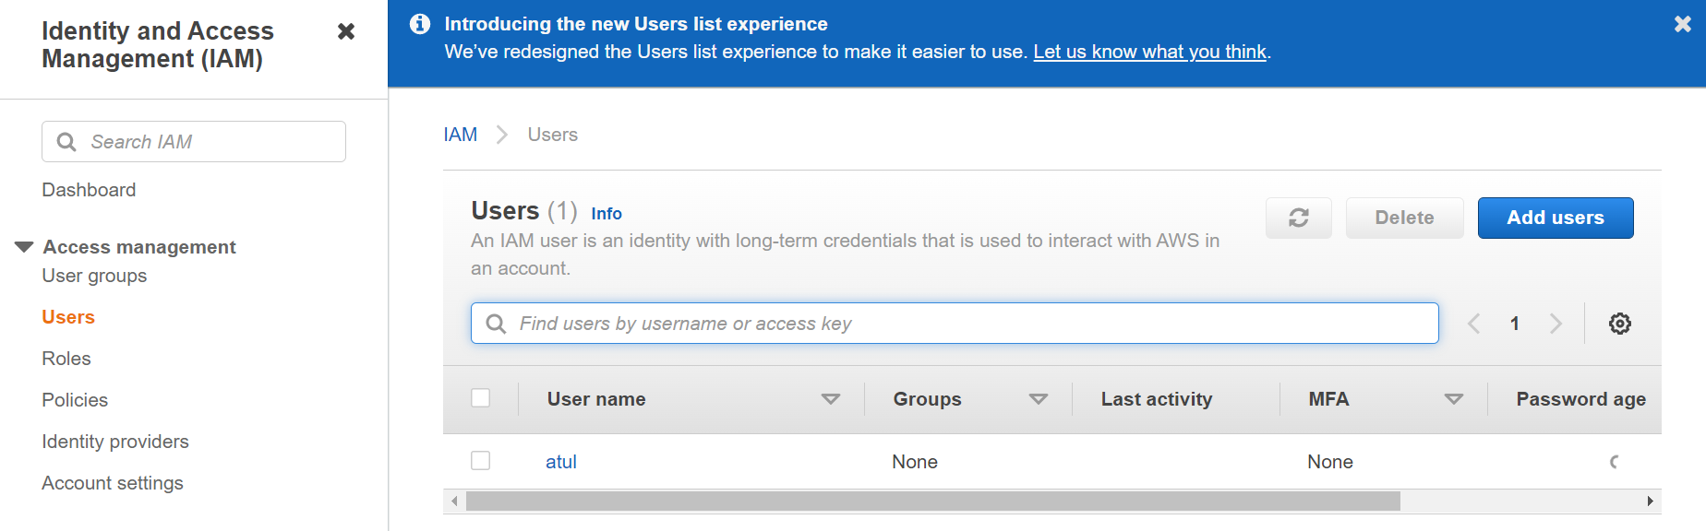
Login with root id now

Slide 28
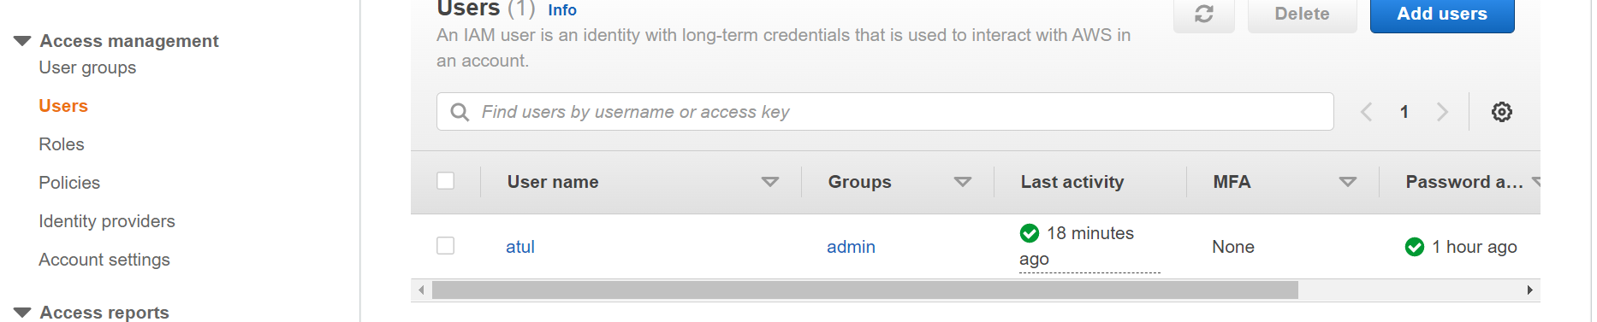
Recreating the Admin permission
Click on the user name
Permissions – Add permissions
Add user to group – Select Admin checkbox – Next: Review
Check by again clicking on ‘Users’ in the left menu

Slide 29
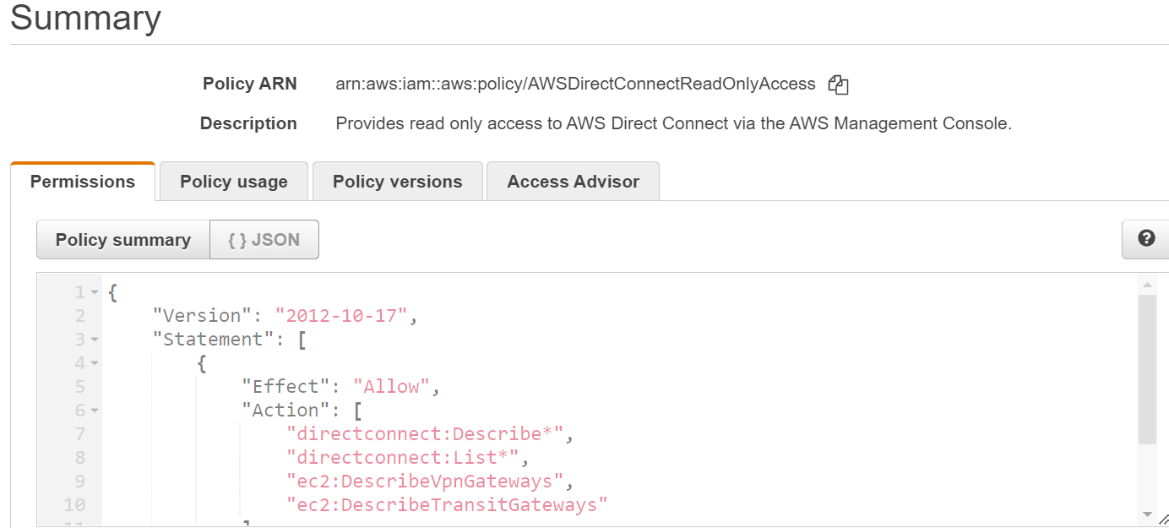
Sample json policy document
Click on Policies, select any policy, and then json

Slide 30
Creating our own policy
Policies – Create policy
Wo options: json or visual editor – Try out

Slide 31
IAM MFA Overview – Passwords
Strong passwords are always better
In AWS, we can setup a password policy:
Set a minimum password length
Require specific character types
Allow/do not allow users to change their passwords
Require users to change their passwords after some time (password expiration)
Prevent password reuse

Slide 32

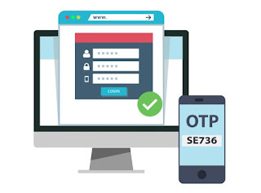


IAM MFA Overview – MFA
Multi Factor Authentication (MFA): Loss of passwords is still ok!
Password you know + Security device you own
+
=>
Password
Second factor
Alice

Slide 33
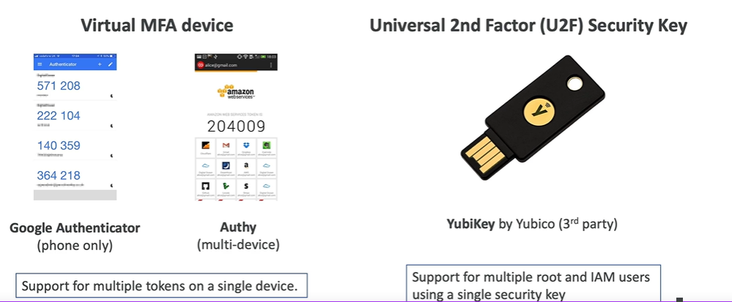
MFA Device Options in AWS – 1

Slide 34
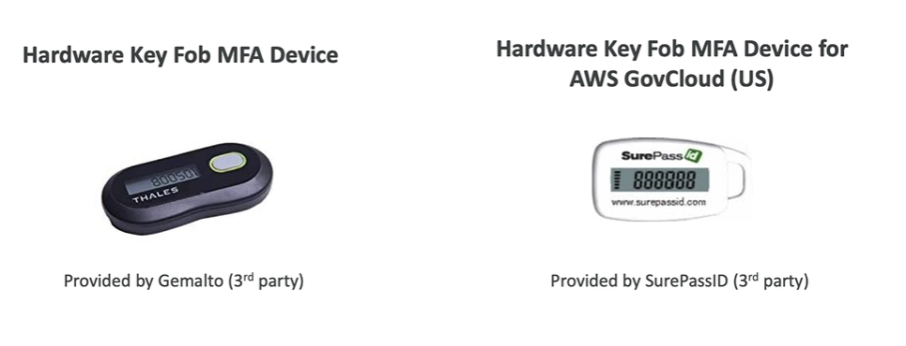
MFA Device Options in AWS – 2

Slide 35
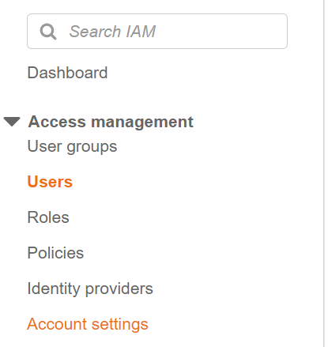
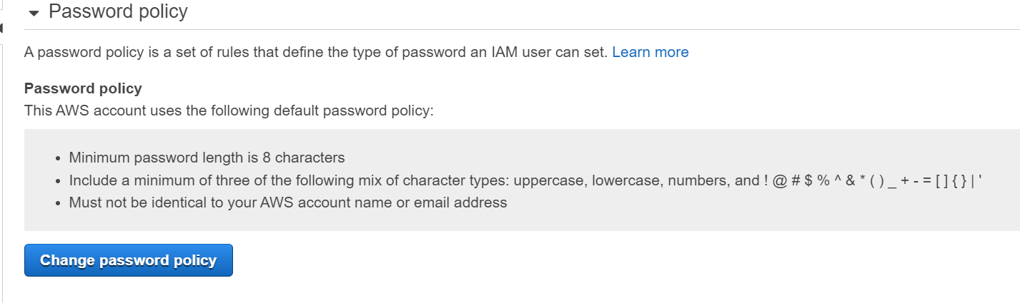
IAM MFA – Hands on
Click on Account Settings

Slide 36
Password Policy
Set some policies
Create new users and test

Slide 37
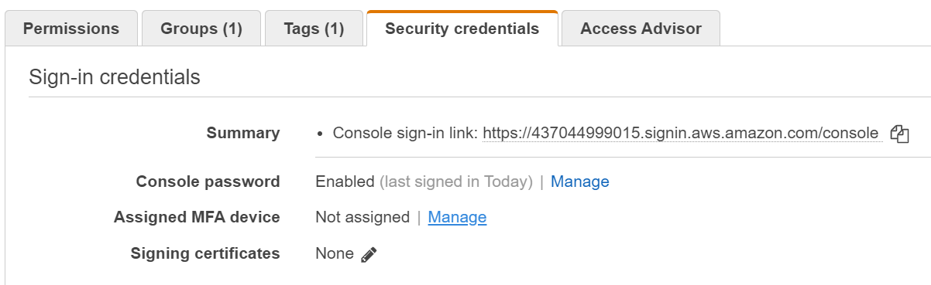
Testing MFA
Create a new user
Click on the user name
Go to Security credentials
Click on Manage for Assigned MFA Device

Slide 38
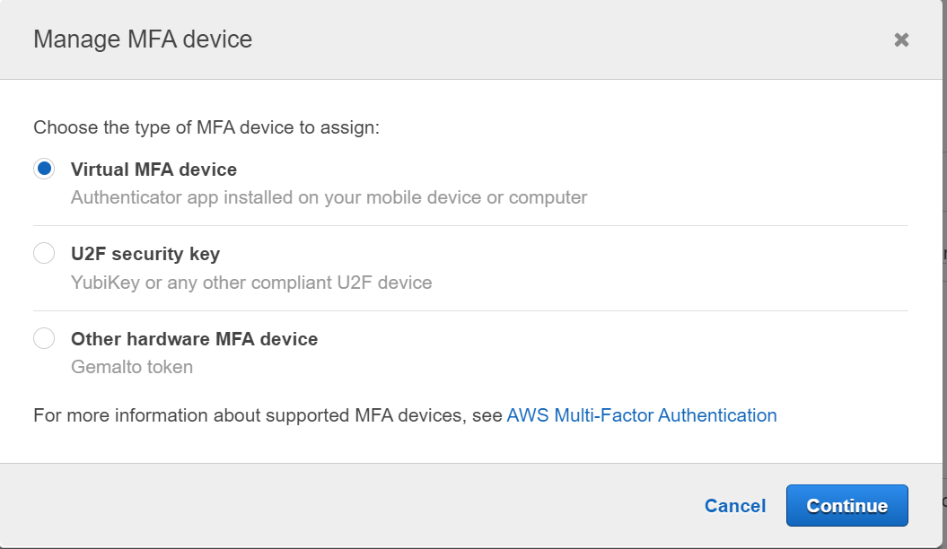
Testing MFA
Select Virtual MFA Device and continue

Slide 39
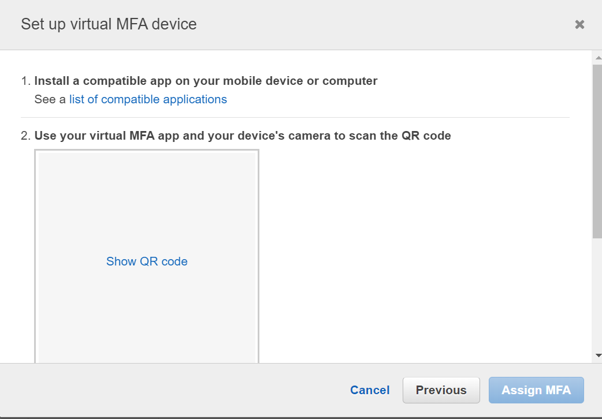
Testing MFA
On the mobile, download Authy and scan the QR code displayed on the AWS screen
The Authy app will show two codes
Enter them on the AWS screen

Slide 40
How can users access AWS?
Three options:
AWS Management Console (Password + MFA)
AWS Command Line Interface – CLI (Access keys)
AWS Software Development Kit – SDK (Code, protected by access keys)
How to generate access keys?
Use AWS console
Users are responsible for their own access keys and need to be kept secret

Slide 41
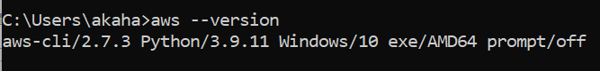
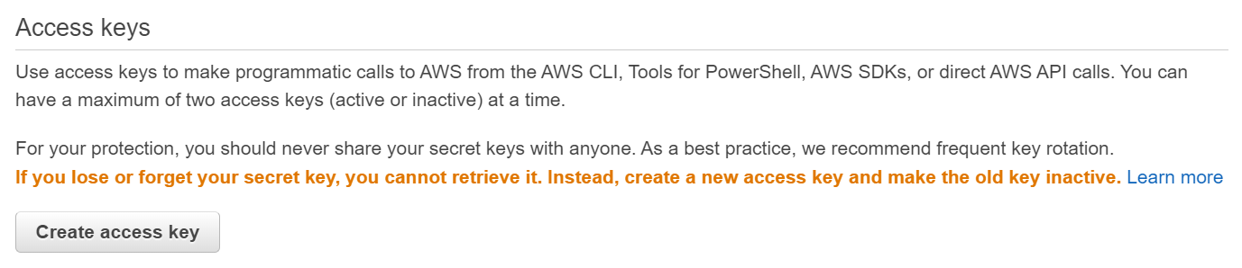
Using AWS CLI
Download (https://aws.amazon.com/cli/) and install AWS CLI
Check version in command prompt:
Create a Access Key for a non-root user in IAM Console

Slide 42
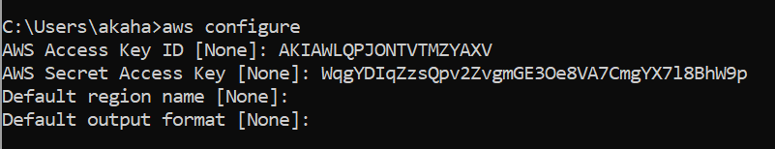
Note the Access Key Id and Secret Access Key
You can download/copy-paste or download the CSV – They will not be shown again for this key
Back to command prompt to configure the CLI using these values

Slide 43
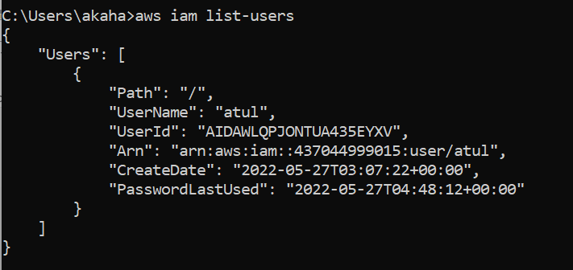
Testing CLI
Try a command such as aws iam list-users

Slide 44
Testing CLI
Exercise:
Create a new user, put her in the admin group
Check this using CLI list-users command
Now remove the admin access to this user (Not Root user)
Then come back to CLI and try the list-users command again
Do we see anything?

Slide 45

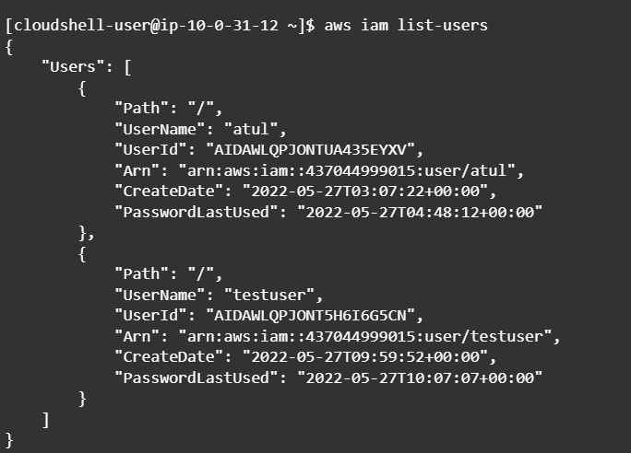
AWS CloudShell
Shell that exists on the AWS console itself
Try a command, e.g. aws iam list-users

Slide 46
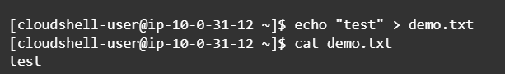
AWS CloudShell
echo “test” > demo.txt
cat demo.txt

Slide 47
EC2

Slide 48
EC2 Basics
One of the most popular AWS offerings
EC2 = Elastic Compute Cloud = IaaS
Capabilities:
Rent a VM (EC2)
Store data on a virtual drive (EBS)
Distribute load across machines (ELB)
Scale the services using auto scaling group (ASG)

Slide 49
EC2 User Data
It is possible to bootstrap our instances using the EC2 User Data
Bootstrapping = Launching commands when a machine starts
This script is run only once at the first start
Used to automate boot tasks such as
Installing updates
Installing software
Downloading common files from the internet
Etc
EC2 User Data script must be run as a root user, so we may need sudo

Slide 50
Create an EC2 Instance using EC2 User Data
Search for EC2, then click on Instances, Launch Instances
Leave everything as default, but click on Create new key pair, as it is required – Give some name, and select defaults
Under Network, select Allow Http traffic from the internet
In Advanced details-User data, enter the following script
#!/bin/bash
# Use this for your user data (script from top to bottom)
# install httpd (Linux 2 version)
yum update -y
yum install -y httpd
systemctl start httpd
systemctl enable httpd
echo "<h1>Hello World from $(hostname -f)</h1>" > /var/www/html/index.html
Launch instance

Slide 51
Test the EC2 Instance
When the instance is running, open its public IP address in the browser

Slide 52
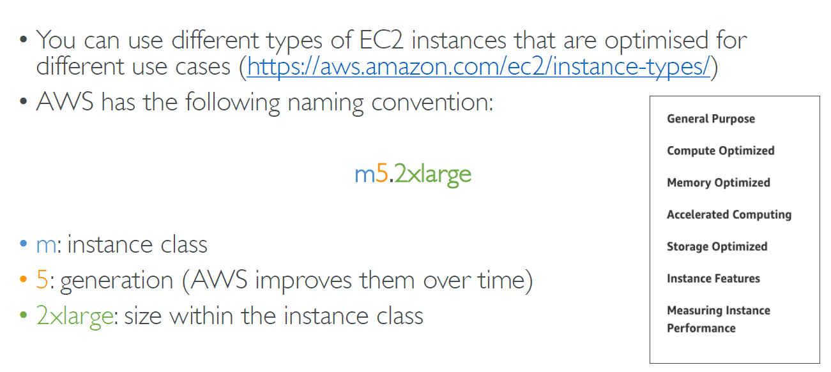
EC2 Instance Types – Overview

Slide 53
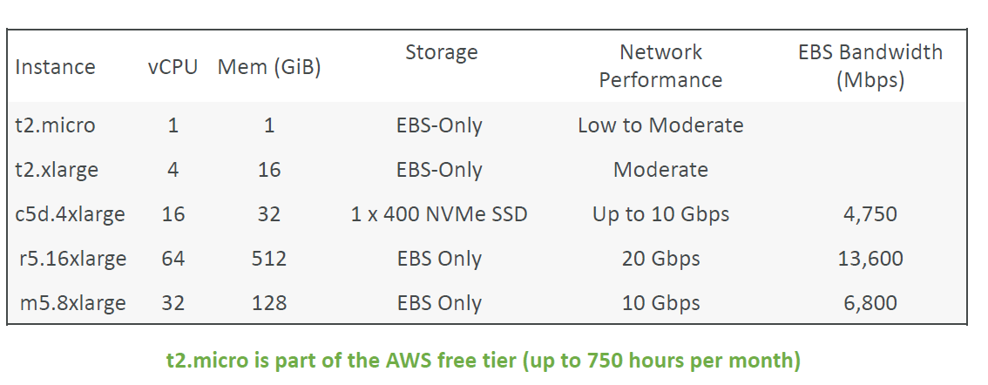
EC2 Instance Types – Example

Slide 54
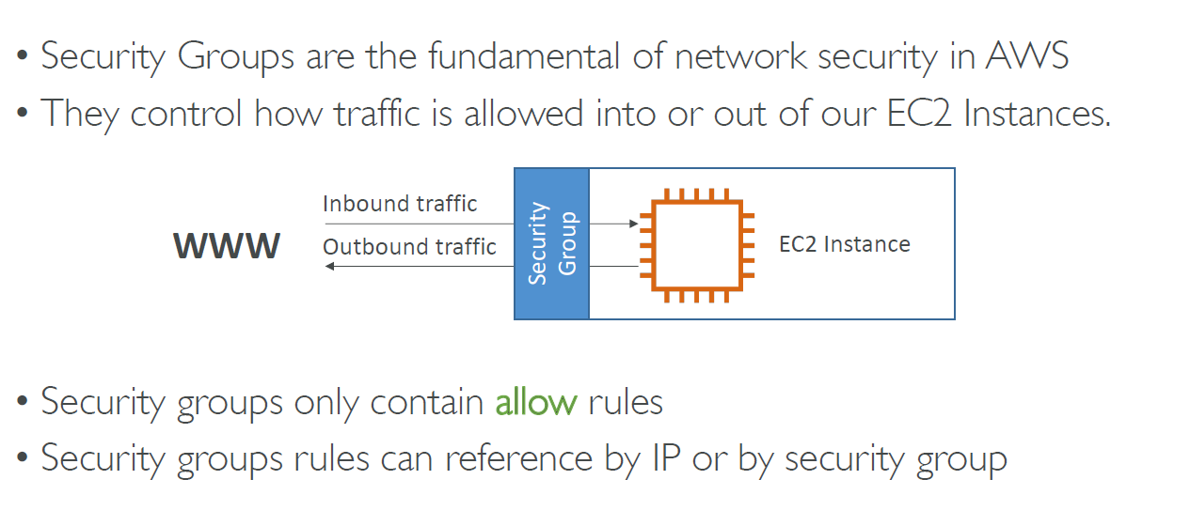
Security Groups and Classic Ports

Slide 55
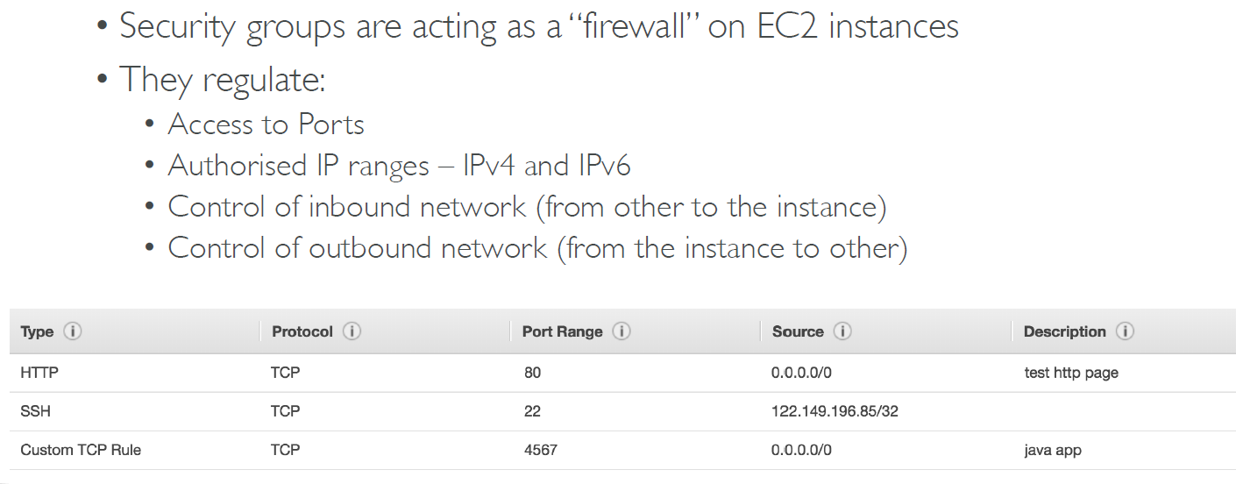
Security Groups

Slide 56
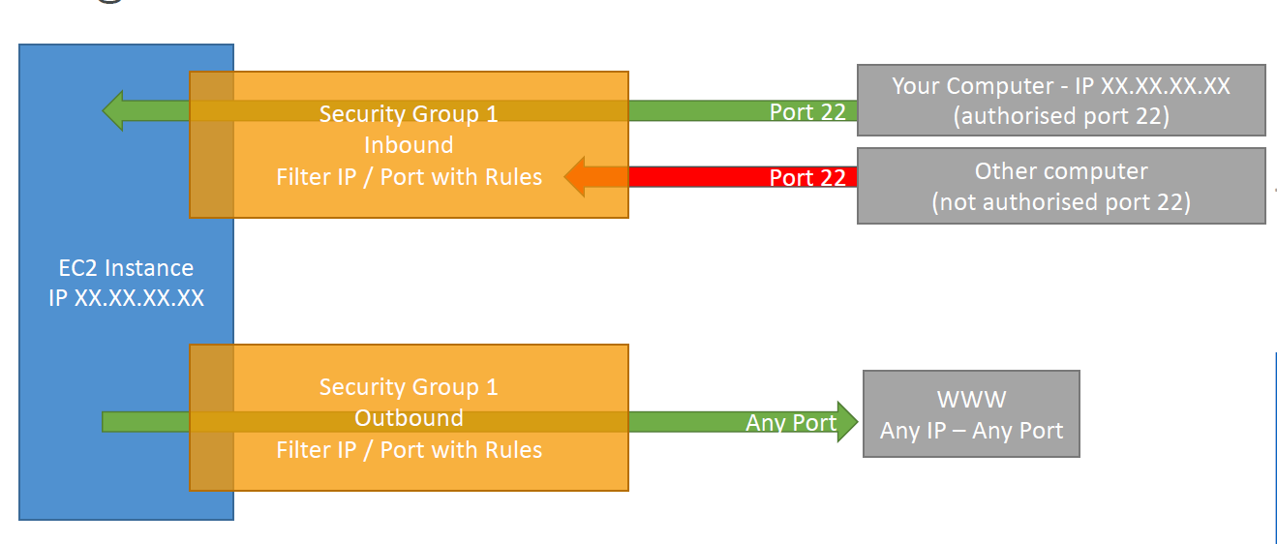
Security Groups - Example

Slide 57
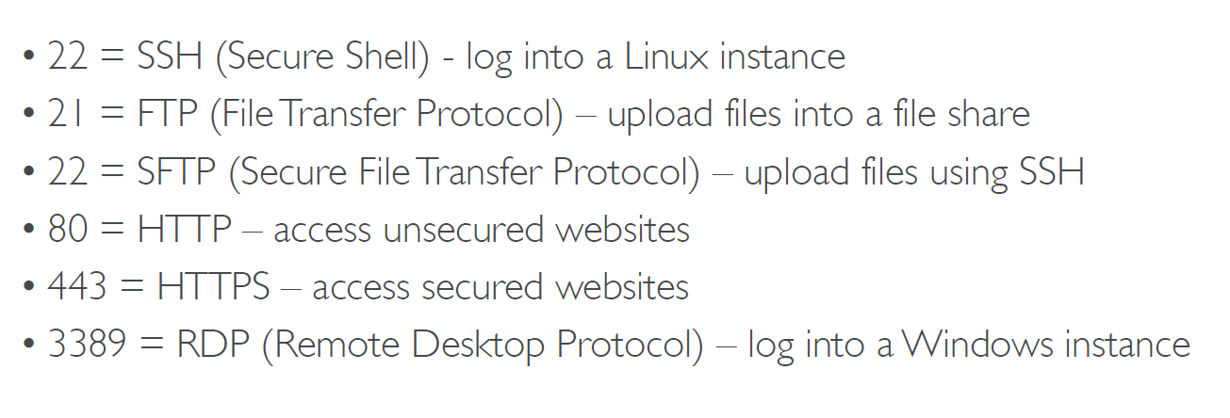
Ports to Remember

Slide 58
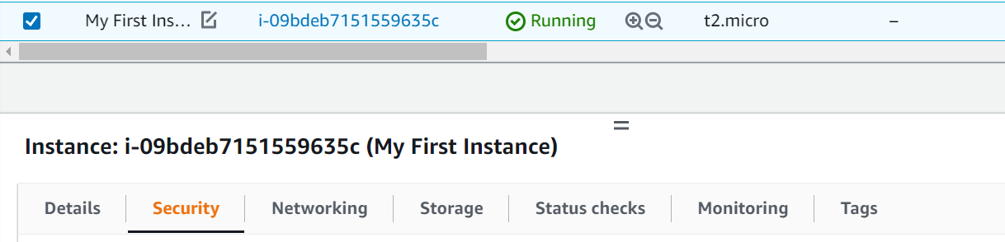
Security Groups – Hands on
Launch an instance, select it and go to ‘Security’ below
Left menu: Network & Security -> Security Groups

Slide 59
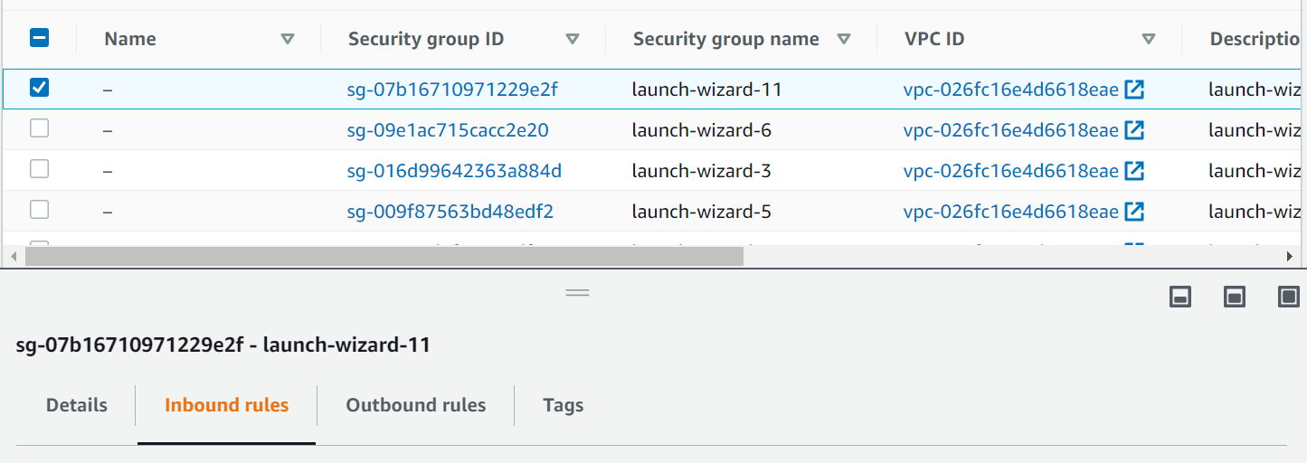
Security Groups – Hands on
Select the latest launched instance and check Inbound rules
SSH is allowed

Slide 60
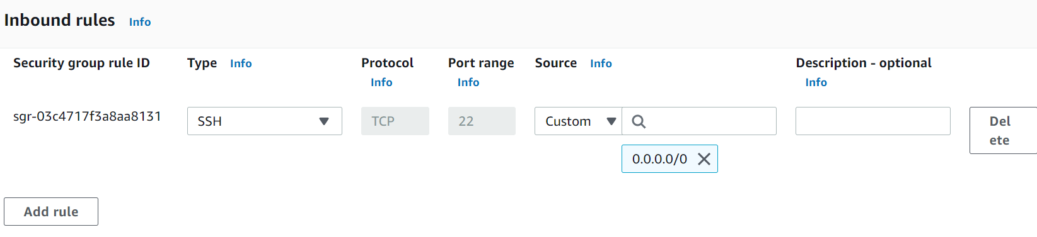
Security Groups – Hands on
Click on Edit Inbound rules to see details
If we see HTTP also, it means outsiders can access our instance, otherwise they cannot – test it (next slide)

Slide 61
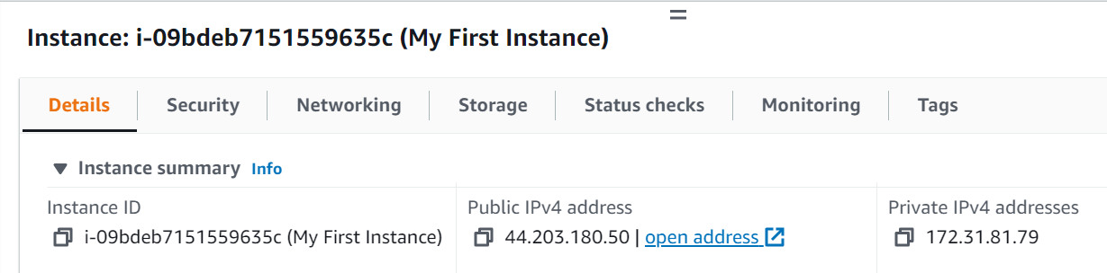
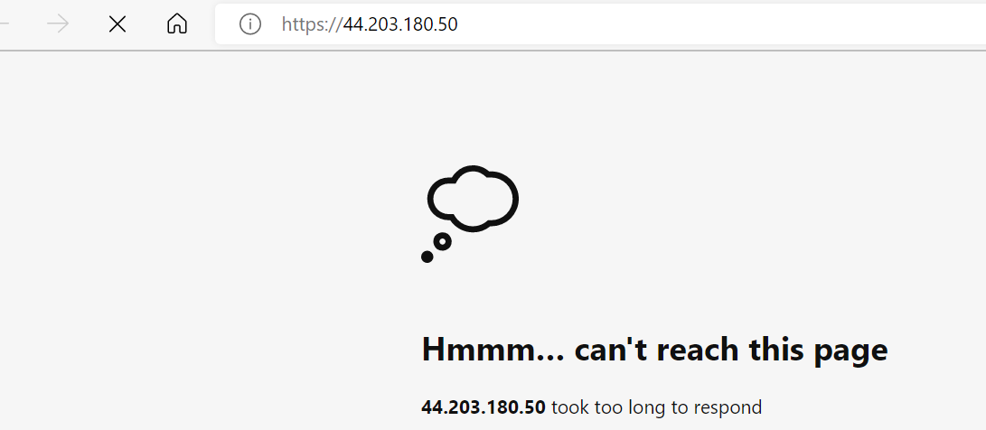
Security Groups – Hands on
Go back to our instance, details and click on the IP Address

Slide 62
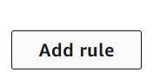
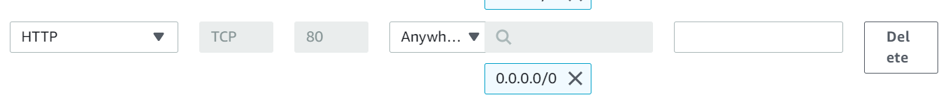

Security Groups – Hands on
If you were able to access, delete HTTP rule and retry then add back HTTP rule in Security policies -> Edit inbound rules

Slide 63

Using SSH – Putty
Download Putty (Windows software to connect to a Linux server using SSH)
First use Putty Gen to convert the private key file that you had downloaded when creating a key pair on EC2 from PEM format into PPT format and save it in the same directory
For this, click on Load

Slide 64



Puttygen

Slide 65


Now try Putty
ec2-user@Our instance’s IP address
SSH -> Auth -> Browse under ‘Private key for authentication’, then Open, Accept in Security alert

Slide 66


Alternative to SSH - EC2 Instance Connect
Start the instance
Select the instance and Connect

Slide 67

EC2 Instance Connect
Under ‘EC2 Instance Connect’ click on Connect

Slide 68

Result

Slide 69
Installing Tomcat Web Server on EC2

Slide 70
Pre-requisites
Create an Amazon Linux EC2 instance with default configurations
Make sure to create a key pair (or use an existing one) and to keep port 80 open
Use putty to connect to the EC2 instance, user name will be ec2-user

Slide 71
Downloading and Installing Tomcat
Install Java
yum install java-1.8* (or sudo yum install java-1.8*)
Install Tomcat
sudo su -
cd /
cd /opt
#Download tomcat binary
wget https://dlcdn.apache.org/tomcat/tomcat-9/v9.0.68/bin/apache-tomcat-9.0.68.tar.gz
#unzip tomcat binary
tar -zvxf apache-tomcat-9.0.68.tar.gz

Slide 72
Downloading and Installing Tomcat
Add permissions to start and stop Tomcat
cd apache-tomcat-9.0.68 (Full directory path is: /opt/ apache-tomcat-9.0.68)
cd bin
chmod +x startup.sh
chmod +x shutdown.sh
Change Tomcat port number from 8080 to 80
cd ..
cd conf
nano server.xml (Here look for 8080 and change it to 80) then Ctrl+X
cd ..
cd bin
./startup.sh

Slide 73

Test: Open Browser and Specify the URL
http://34.201.59.231:80

Slide 74
Creating ‘Hello World’
Go to /opt/apache…/webapps directory
mkdir cdac
cd cdac
nano hello.jsp
<%
out.println (“Hello World”);
%>
mkdir WEB-INF (Inside cdac directory)
cd WEB-INF
nano web.xml
<? xml version = “1.0” ?>
<web-app>
</web-app>

Slide 75
Start Tomcat Server
cd ..
cd ..
cd bin
./startup.sh

Slide 76

Testing

Slide 77
User Authentication, Authorization, and Confidentiality on the Tomcat Server

Slide 78
Adding User Authentication
Edit tomcat/conf/tomcat-users.xml to add a user:
<user username = "cdac" password = "cdac" roles = "manager" />

Slide 79
Adding User Authentication
Edit tomcat/webapps/cdac/WEB-INF/web.xml to add the following:
<?xml version = "1.0" ?>
<web-app>
<security-constraint>
<web-resource-collection>
<web-resource-name>My JSP</web-resource-name>
<url-pattern>/test.jsp</url-pattern>
<http-method>GET</http-method>
<http-method>POST</http-method>
</web-resource-collection>
<auth-constraint>
<role-name>manager</role-name>
</auth-constraint>
<user-data-constraint>
<transport-guarantee>CONFIDENTIAL</transport-guarantee>
</user-data-constraint>
</security-constraint>
<login-config>
<auth-method>BASIC</auth-method>
</login-config>
<security-role>
<role-name>manager</role-name>
</security-role>
</web-app>

Slide 80
Test
Restart tomcat server and check the URL <ip address>/cdac/test.jsp in the browser
It should ask for user id and password

Slide 81
Adding Confidentiality/SSL/TLS
First create a public-private key pair in the EC2 instance:
keytool –genkey –alias tomcat –keyalg RSA
Make sure the password is changeit
Export the public key into a file:
keytool -exportcert -file cloudcert.p12 -alias tomcat
This file needs to be exported into our desktop/local Web browser store
For this, we will need to download this file from the EC2 instance to our local machine (See next slide)

Slide 82
Downloading the .p12 File From EC2 Instance
Install a tool called WinSCP – Allows us to download/upload files between local machine and EC2 instance
Select File Protocol as SCP
We need to provide EC2 instance’s Public IPv4 DNS (e.g. ec2-54-234-48-116.compute-1.amazonaws.com) for our EC2 instance in this tool
User id: ec2-user, No password, then Advanced, provide the private key file for authentication and connect
It then shows our desktop and EC2 instance files side-by-side (See next slide)
We can drag and drop files from one to the other, as if they are both local machines
For non-Windows machines: scp command - https://linuxhint.com/transfer-files-ec2-instance/ (For timeouts, try this: https://superuser.com/questions/577911/scp-lost-connection-but-ssh-works-fine)

Slide 83

WinSCP Screen

Slide 84

Go to opt directory
You will see cloudcert.p12 file
Drag it to your local machine in some folder

Slide 85
Add the File to Browser Certificate Store
Open the browser, Settings->Privacy and security->Manage device certificates->Trusted root->Import->cloudcert.p12

Slide 86
Edit the server.xml file on EC2 tomcat/conf Directory
Edit the following to change port 8443 to 443:
<Connector port="80" protocol="HTTP/1.1"
connectionTimeout="20000"
redirectPort="443" />
Below, do this where you see 8443 and uncomment it:
<Connector port="443" protocol="org.apache.coyote.http11.Http11NioProtocol"
maxThreads="150" SSLEnabled="true">
<SSLHostConfig>
<Certificate certificateKeystoreFile="/root/.keystore"
type="RSA" />
</SSLHostConfig>
</Connector>

Slide 87
Edit tomcat/webapps/cdac/WEB-INF/web.xml
<?xml version = "1.0" ?>
<web-app>
<security-constraint>
<web-resource-collection>
<web-resource-name>My JSP</web-resource-name>
<url-pattern>/test.jsp</url-pattern>
<http-method>GET</http-method>
<http-method>POST</http-method>
</web-resource-collection>
<auth-constraint>
<role-name>manager</role-name>
</auth-constraint>
<user-data-constraint>
<transport-guarantee>CONFIDENTIAL</transport-guarantee>
</user-data-constraint>
</security-constraint>
<login-config>
<auth-method>BASIC</auth-method>
</login-config>
<security-role>
<role-name>manager</role-name>
</security-role>
</web-app>

Slide 88

Enable Port 443 on the EC2 Instance
Stop the instance
Select it and click on Security-><Link below Security groups>, e.g.
Inbound rules->Edit inbound rules
Add rule -> HTTPS -> Port 443 -> Source Custom 0.0.0.0/0 -> Save rules

Slide 89

Try the URL in the browser
http://54.234.48.116:80/cdac/hello.jsp

Slide 90
ELB and ASG – Elastic Load Balancing and Auto Scaling Groups

Slide 91
Scalability and High Availability
Scalability: An application/system can handle greater loads by adapting
Scalability types
Vertical
Horizontal (= Elasticity)
Scalability and Availability are related, but they are not the same things

Slide 92
Vertical Scalability
Increasing the size of the instance
Example: Currently, our application runs on a t2.micro
Scaling it will mean running it on a t2.large
Very common for non-distributed systems, such as a database
Upper limit is decided by the capacity of the hardware

Slide 93
Horizontal Scalability
Distributed system
Very common for web/modern applications

Slide 94
High Availability
Generally linked to horizontal scaling
High availability means running an application in at least two Availability Zones
Goal: Survive a data center loss

Slide 95
Summary: High Availability and Scalability for EC2
Vertical scaling: Increase instance size (= scale up/down)
From t2.nano – 0.5 GB RAM, 1 vCPU
To u12tbl.metal – 12.3 GB RAM,448 vCPUs
Horizontal scaling: Increase number of instances (= scale out/in)
Auto Scaling Group (ASG)
Load balancer
High Availability: Run instances for the same application across multi Availability Zones (AZ)
Auto Scaling Group multi AZ
Load balancer multi AZ

Slide 96
Key Terminology
Scalability: Ability to accommodate a larger load by making the hardware stronger (scale up) or by adding nodes (scale out)
Elasticity: A scalable system can be elastic – this means that based on the load, the system can auto-scale. Pay-per-use model
Agility: Nothing to do with scalability – it simply means that an organization is ready to work fast

Slide 97

What is Load Balancing?

Slide 98

Why use a Load Balancer?

Slide 99

Why use an Elastic Load Balancer (ELB)?

Slide 100






Load Balancing Hands-on
Launch an instance

Slide 101
Launch another Instance and test
Same characteristics as the first one, the subnet should be us-east-1b
Check both in the browser

Slide 102




ALB Creation
Select Load Balancers from the Load Balancing option on the left
Click Create button for Application Load Balancer
Under Mappings:

Slide 103




Security Groups
Click on Create new security group
Come back to Load Balancers and
select the new SG

Slide 104


Listeners and Routing
Click on Create target group
Select other defaults and Next

Slide 105

Listeners and Routing
Select both instances and click Include as pending below
Select other defaults and Next

Slide 106

Listeners and Routing
Scroll down
Click on Create target group button below

Slide 107

Result

Slide 108

Go back to ALB screen
Select demo-tg in the dropdown

Slide 109



Create load balancer and come back
Test by using the DNS name link of the Load Balancer
Refresh: Two different instances are responding

Slide 110



View Target Groups – Explains how Load Balancing is happening

Slide 111


Stop one of the Instances
Instances – Select – Stop
Verify in Target groups - Targets
Now refresh browser – always the same response

Slide 112
Stop one of the Instances
Restart the instance and refresh browser – again load balancing in action

Slide 113

What is an Auto Scaling Group (ASG)?

Slide 114
What is an Auto Scaling Group (ASG)?

Slide 115

Auto Scaling Group (ASG)

Slide 116


Auto Scaling Group (ASG) – Hands on
First, terminate the two instances we had created earlier
In the left menu, scroll till the bottom and select Auto Scaling Groups
Give a name and click on
Create a launch template
We will then use the template
to launch instances

Slide 117


Defining the Template – 1
For this, click the drop down
of AMI

Slide 118


Defining the Template – 2

Slide 119

Defining the Template – 3

Slide 120


Defining the Template – 4

Slide 121

Back to Auto Scaling Groups screen

Slide 122

Availability Zones and subnets – Click one by one on the first three in the dropdown

Slide 123

Load balancing
Select Attach to an existing load balancer -> Choose from your load balancer target groups -> From dropdown, select demo-tg
Also select ELB check
box in Health checks

Slide 124

Group size
Select Attach to an existing load balancer -> Choose from your load balancer target groups -> From dropdown, select demo-tg
Remaining defaults, Next
Again Next
Create Auto Scaling group

Slide 125


ASG created – 1
Select DemoASG and click on Instance management

Slide 126

ASG created – 2
What has happened?
Two instances were automatically created
Verify in Instances

Slide 127

ASG created – 3
Also verify in Target Groups (Refresh Targets if it is showing old information)

Slide 128

Test: Go to Load Balancer and get the URL

Slide 129



Test: Try the URL and refresh

Slide 130
Verify
Terminate one of the instances and retest
ASG, Target groups, Load balancer, browser all work as expected
So, a fresh instance got created automatically
Remember to delete the ASG

Slide 131
Serverless and Lambda

Slide 132
What is Serverless?
Serverless does not mean no server
Serverless means the developers do not have to worry about servers
Developers just need to deploy code

Slide 133

Lambda Overview

Slide 134

Lambda Advantages

Slide 135

Lambda Example

